Slide 1
Lexical Analyzer
(Last Part)

Slide 2
Design of a Lexical Analyzer Generator
Translate regular expressions to NFA
Translate NFA to an efficient DFA
Optional
regular expressions
NFA
DFA
Simulate NFA to recognize tokens
Simulate DFA to recognize tokens

Slide 3
Nondeterministic Finite Automata
Definition: an NFA is a 5-tuple (S,Σ,δ,s₀,F) where S is a finite set of states Σ is a finite set of input symbol alphabet δ is a mapping from S×Σ to a set of states s₀ ∈ S is the start state F ⊆ S is the set of accepting (or final) states

Slide 4
Transition Graph
An NFA can be diagrammatically represented by a labeled directed graph called a transition graph
a
S = {0,1,2,3} Σ = {a,b} s₀ = 0 F = {3}
start
a
b
b
0
1
2
3
b

Slide 5
Transition Table
The mapping δ of an NFA can be represented in a transition table
State | Input a | Input b
0 | {0, 1} | {0}
1 |  | {2}
2 |  | {3}
δ(0,a) = {0,1} δ(0,b) = {0} δ(1,b) = {2} δ(2,b) = {3}

Slide 6
The Language Defined by an NFA
An NFA accepts an input string x iff there is some path with edges labeled with symbols from x in sequence from the start state to some accepting state in the transition graph
A state transition from one state to another on the path is called a move
The language defined by an NFA is the set of input strings it accepts, such as (a|b)*abb for the example NFA

Slide 7
Design of a Lexical Analyzer Generator: RE to NFA to DFA
Lex specification with regular expressions
NFA
p₁ { action₁ } p₂ { action₂ } … p_{n} { action_{n} }
action₁
ε
N(p₁)
start
ε
N(p₂)
action₂
s₀
ε
…
N(p_{n})
action_{n}
Subset construction (optional)
DFA

Slide 8
From Regular Expression to NFA (Thompson’s Construction)
ε
start
ε
i
f
a
start
a
i
f
ε
ε
start
N(r₁)
r₁ | r₂
i
f
ε
N(r₂)
ε
r₁r₂
start
i
N(r₁)
N(r₂)
f
ε
r*
start
ε
ε
i
N(r)
f
ε

Slide 9
Combining the NFAs of a Set of Regular Expressions
start
a
1
2
a { action₁ } abb { action₂ } a*b+ { action₃ }
start
a
b
b
3
4
5
6
a
b
start
7
b
8
a
1
2
ε
start
ε
a
b
b
0
3
4
5
6
a
b
ε
7
b
8

Slide 10
Simulating the Combined NFA Example 1
a
action₁
1
2
ε
start
ε
a
b
b
0
3
4
5
6
action₂
a
b
ε
7
8
action₃
b
a
a
b
a
none
0
1
3
7
2
4
7
7
8
action₃
Must find the longest match: Continue until no further moves are possible When last state is accepting: execute action

Slide 11
Simulating the Combined NFA Example 2
a
action₁
1
2
ε
start
ε
a
b
b
0
3
4
5
6
action₂
a
b
ε
7
8
action₃
b
a
b
b
a
none
0
1
3
7
2
4
7
5
8
6
8
action₂ action₃
When two or more accepting states are reached, the first action given in the Lex specification is executed

Slide 12
Deterministic Finite Automata
A deterministic finite automaton is a special case of an NFA
No state has an ε-transition
For each state s and input symbol a there is at most one edge labeled a leaving s
Each entry in the transition table is a single state
At most one path exists to accept a string
Simulation algorithm is simple

Slide 13
Example DFA
A DFA that accepts (a|b)*abb
b
b
a
start
a
b
b
0
1
2
3
a
a

Slide 14
Conversion of nfa to dfa
Why?
DFA is difficult to construct directly from RE’s
NFA is difficult to represent in a computer program and inefficient to compute
Conversion algorithm: subset construction
The idea is that each DFA state corresponds to a set of NFA states.
After reading input a1, a2, …, an, the DFA is in a state that represents the subset T of the states of the NFA that are reachable from the start state.

Slide 15
Conversion of an NFA into a DFA
The subset construction algorithm converts an NFA into a DFA using: ε-closure(s) = {s} ∪ {t | s →_{ε} … →_{ε} t} ε-closure(T) = ∪_{s∈T} ε-closure(s) move(T,a) = {t | s →_{a} t and s ∈ T}
The algorithm produces: Dstates is the set of states of the new DFA consisting of sets of states of the NFA Dtran is the transition table of the new DFA

Slide 16
ε-closure and move Examples
ε-closure({0}) = {0,1,3,7} move({0,1,3,7},a) = {2,4,7} ε-closure({2,4,7}) = {2,4,7} move({2,4,7},a) = {7} ε-closure({7}) = {7} move({7},b) = {8} ε-closure({8}) = {8} move({8},a) = ∅
a
1
2
ε
start
ε
a
b
b
0
3
4
5
6
a
b
ε
7
b
8
a
a
b
a
none
0
1
3
7
2
4
7
7
8
Also used to simulate NFAs

Slide 17
Simulating an NFA using ε-closure and move
S := ε-closure({s₀}) S_{prev} := ∅ a := nextchar() while S ≠ ∅ do S_{prev} := S S := ε-closure(move(S,a)) a := nextchar() end do if S_{prev} ∩ F ≠ ∅ then execute action in S_{prev} return “yes” else return “no”

Slide 18
The Subset Construction Algorithm
Initially, ε-closure(s₀) is the only state in Dstates and it is unmarked while there is an unmarked state T in Dstates do mark T for each input symbol a ∈ Σ do U := ε-closure(move(T,a)) if U is not in Dstates then add U as an unmarked state to Dstates end if Dtran[T,a] := U end do end do

Slide 19
Subset Construction Example 1
ε
a
2
3
ε
ε
ε
ε
start
a
b
b
0
1
6
7
8
9
10
ε
ε
b
4
5
ε
b
Dstates A = {0,1,2,4,7} B = {1,2,3,4,6,7,8} C = {1,2,4,5,6,7} D = {1,2,4,5,6,7,9} E = {1,2,4,5,6,7,10}
C
b
a
b
start
a
b
b
A
B
D
E
a
a
a

Slide 20
Subset Construction Example 2
a
a₁
1
2
ε
start
ε
a
b
b
0
3
4
5
6
a₂
a
b
ε
7
8
a₃
b
b
Dstates A = {0,1,3,7} B = {2,4,7} C = {8} D = {7} E = {5,8} F = {6,8}
a₃
C
b
a
b
b
start
A
D
a
a
b
b
B
E
F
a₁
a₃
a₂ a₃

Slide 21
Minimizing the Number of States of a DFA
b
C
b
a
b
a
start
a
b
b
start
a
b
b
A
B
D
E
A
B
D
E
a
a
a
a
b
a

Slide 22
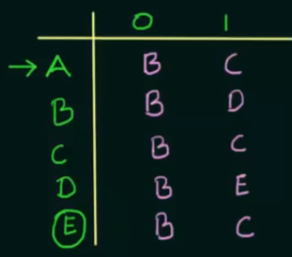
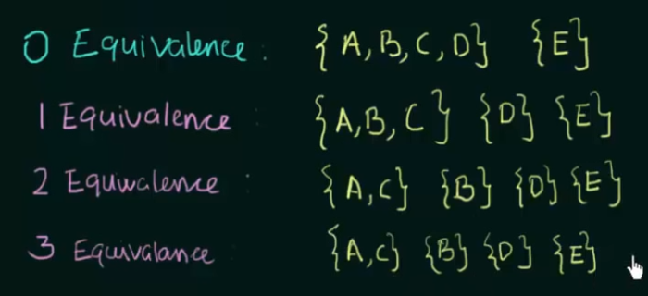
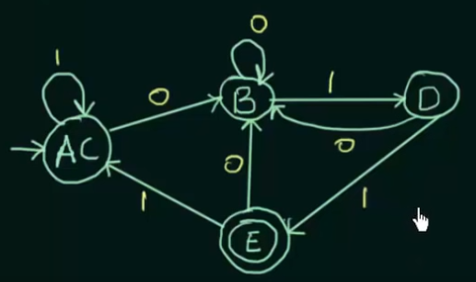
Minimization of dfa

Slide 23
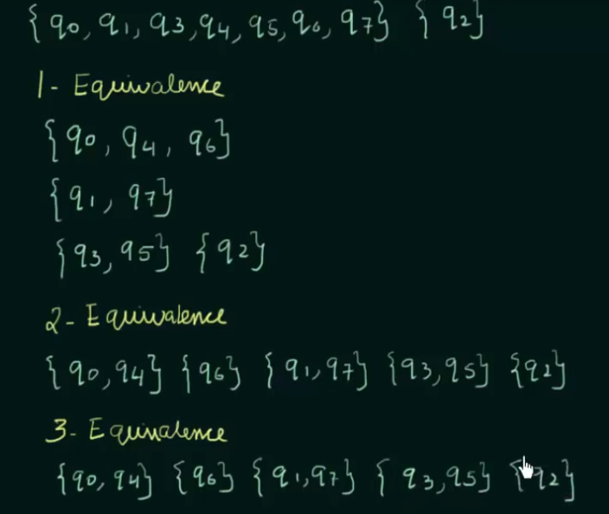
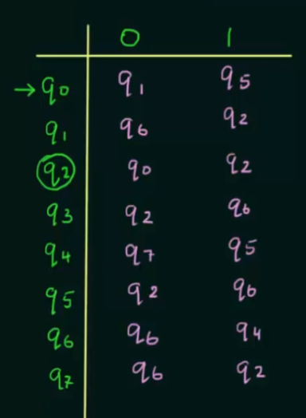
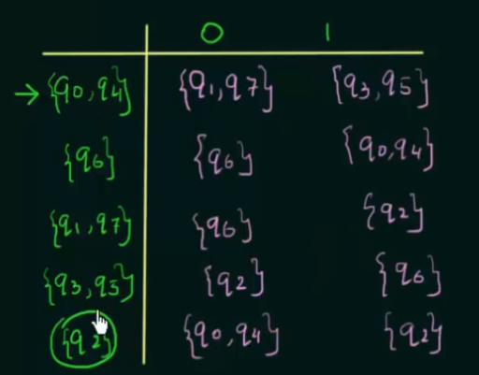
TRY This!!!!

Slide 24
From Regular Expression to DFA Directly
The important states of an NFA are those without an ε-transition, that is if move({s},a) ≠ ∅ for some a then s is an important state
The subset construction algorithm uses only the important states when it determines ε-closure(move(T,a))

Slide 25
From Regular Expression to DFA Directly (Algorithm)
Augment the regular expression r with a special end symbol # to make accepting states important: the new expression is r#
Construct a syntax tree for r#
Traverse the tree to construct functions nullable, firstpos, lastpos, and followpos

Slide 26
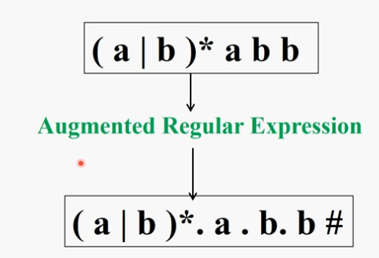
STEP-1

Slide 27
STEP-2
concatenation
#
6
b
closure
5
b
4
*
a
alternation
3
|
position number
(for leafs ≠ε)
a
b
1
2

Slide 28
STEP-3: Annotating the Tree
nullable(n): the subtree at node n generates languages including the empty string
firstpos(n): set of positions that can match the first symbol of a string generated by the subtree at node n
lastpos(n): the set of positions that can match the last symbol of a string generated by the subtree at node n
followpos(i): the set of positions that can follow position i in the tree

Slide 29
From Regular Expression to DFA Directly: Annotating the Tree
Node n | nullable(n) | firstpos(n) | lastpos(n)
Leaf ε | true | ∅ | ∅
Leaf i | false | {i} | {i}
| / \ c₁ c₂ | nullable(c₁) or nullable(c₂) | firstpos(c₁) ∪ firstpos(c₂) | lastpos(c₁) ∪ lastpos(c₂)
• / \ c₁ c₂ | nullable(c₁) and nullable(c₂) | if nullable(c₁) then firstpos(c₁) ∪ firstpos(c₂) else firstpos(c₁) | if nullable(c₂) then lastpos(c₁) ∪ lastpos(c₂) else lastpos(c₂)
* | c₁ | true | firstpos(c₁) | lastpos(c₁)

Slide 30
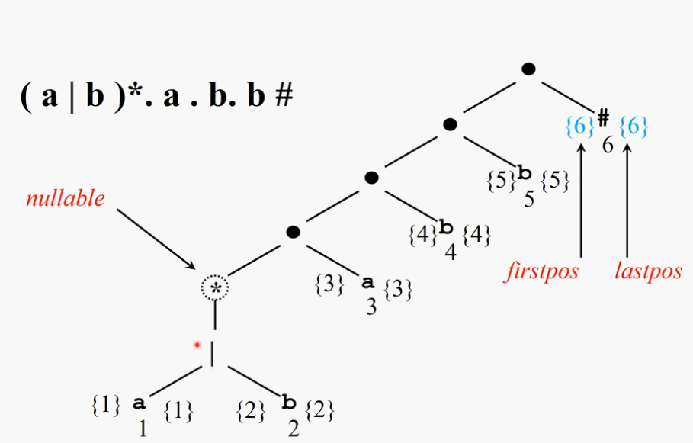
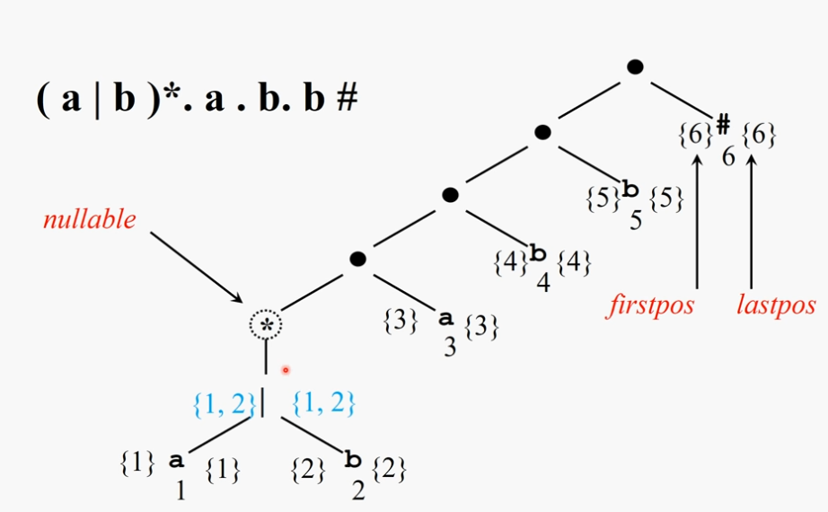
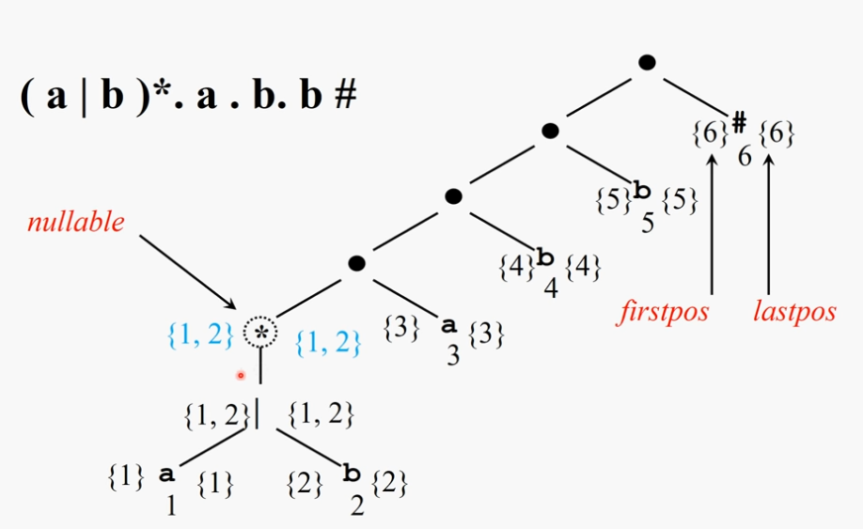
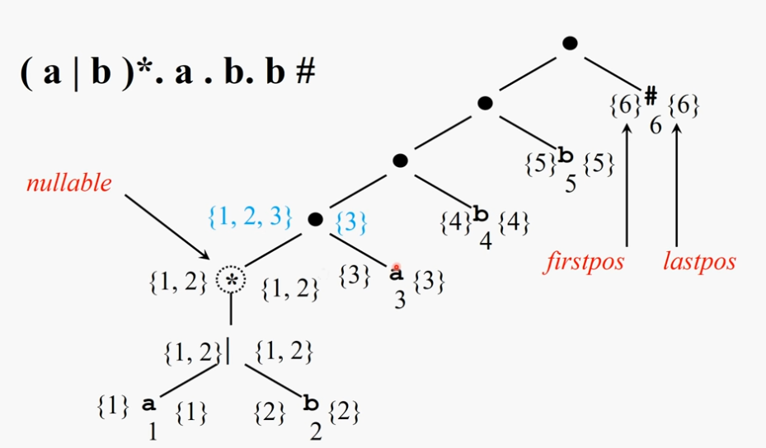

Slide 31
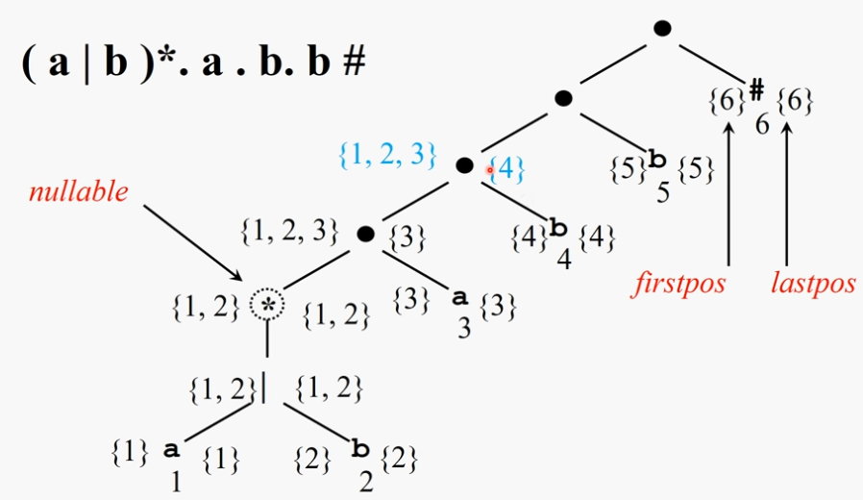
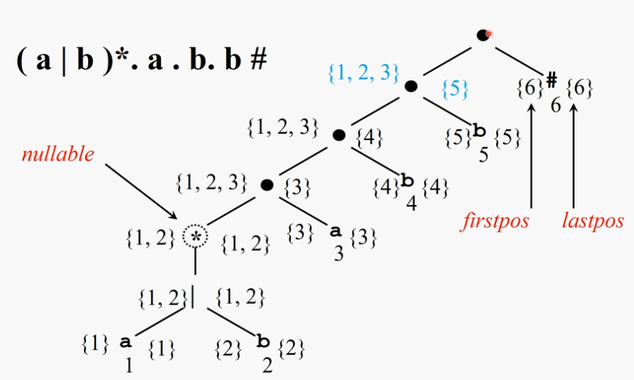

Slide 32
From Regular Expression to DFA Directly: Syntax Tree of (a|b)*abb#
{1, 2, 3}
{6}
{1, 2, 3}
{5}
{6}
#
{6}
6
{1, 2, 3}
{4}
{5}
b
{5}
nullable
5
{1, 2, 3}
{3}
{4}
b
{4}
4
firstpos
lastpos
{1, 2}
*
{1, 2}
{3}
a
{3}
3
{1, 2}
|
{1, 2}
{1}
a
{1}
{2}
b
{2}
1
2

Slide 33
From Regular Expression to DFA Directly: followpos
for each node n in the tree do if n is a cat-node with left child c₁ and right child c₂ then for each i in lastpos(c₁) do followpos(i) := followpos(i) ∪ firstpos(c₂) end do else if n is a star-node for each i in lastpos(n) do followpos(i) := followpos(i) ∪ firstpos(n) end do end if end do

Slide 34
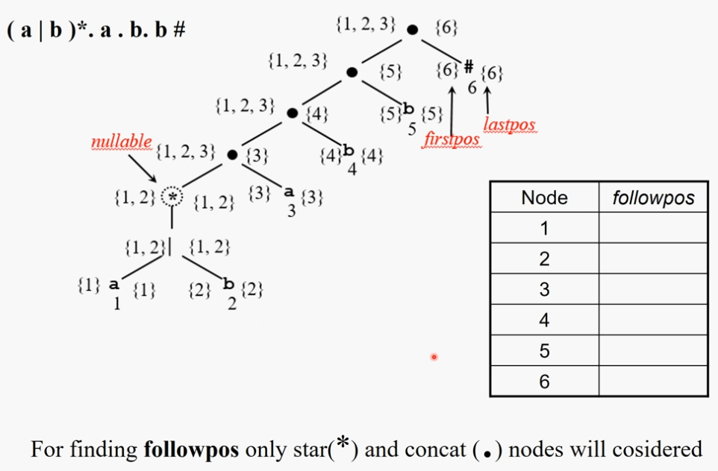
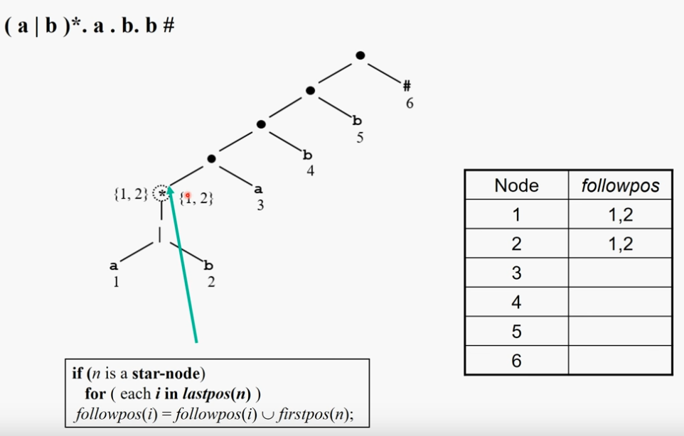
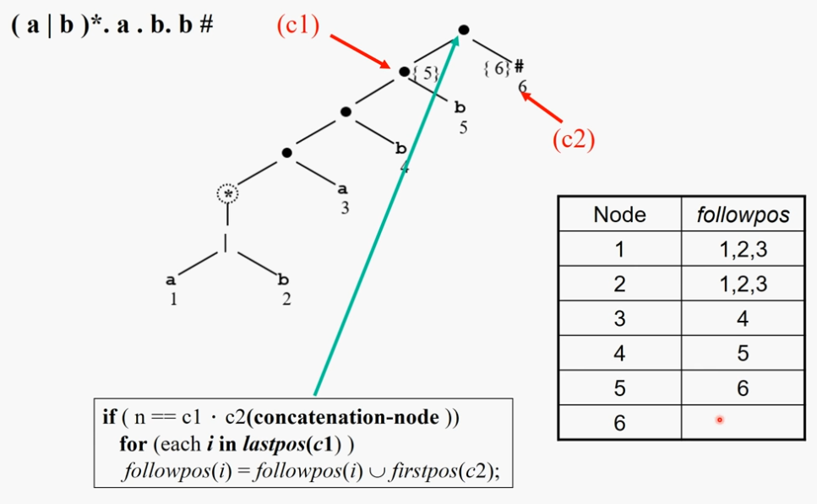

Slide 35
From Regular Expression to DFA Directly: Algorithm
s₀ := firstpos(root) where root is the root of the syntax tree Dstates := {s₀} and is unmarked while there is an unmarked state T in Dstates do mark T for each input symbol a ∈ Σ do let U be the set of positions that are in followpos(p) for some position p in T, such that the symbol at position p is a
if U is not empty and not in Dstates then add U as an unmarked state to Dstates end if Dtran[T,a] := U end do end do

Slide 36
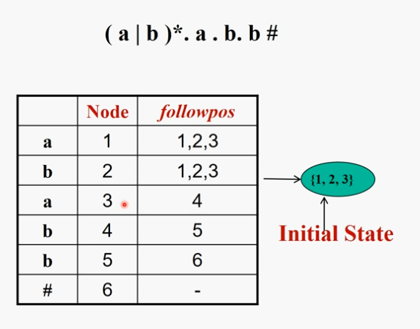
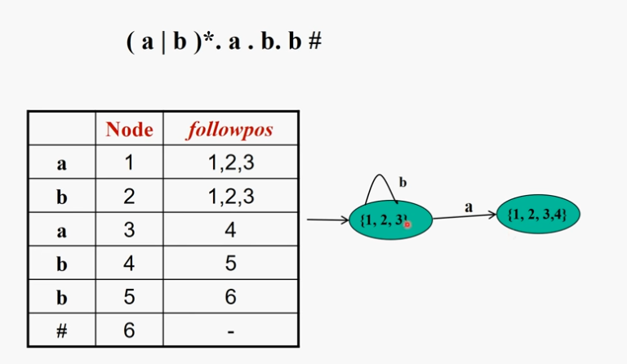
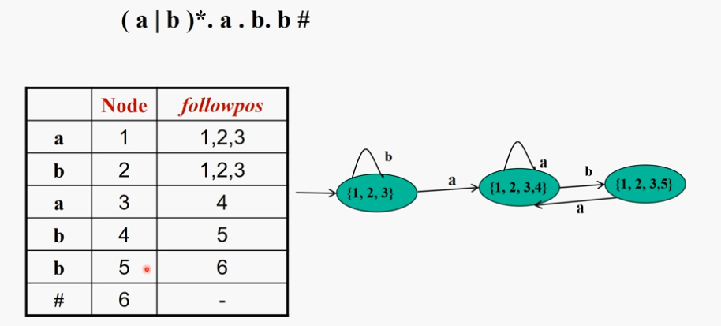
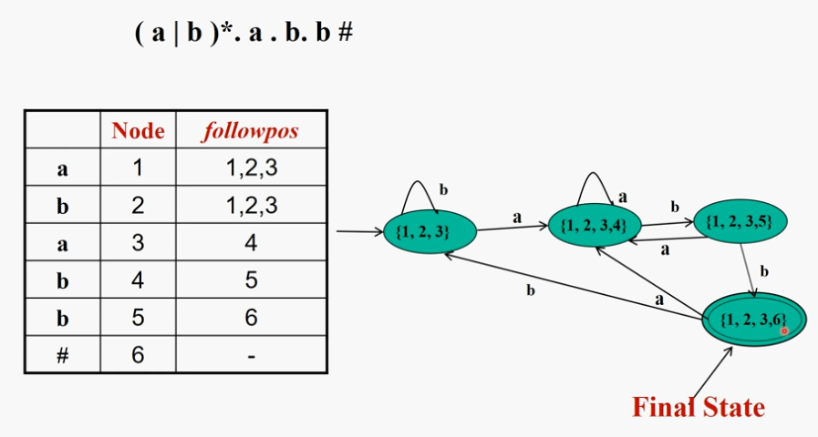

Slide 37
From Regular Expression to DFA Directly: Example
Node | followpos
1 | {1, 2, 3}
2 | {1, 2, 3}
3 | {4}
4 | {5}
5 | {6}
6 | -
1
3
4
5
6
2
b
b
a
start
1,2,3
a
1,2, 3,4
b
1,2, 3,5
b
1,2, 3,6
a
a

Slide 38
RE to DFA directly
TRY Yourself:
(a+b)*+(a.c)*

Slide 39
Time-Space Tradeoffs
Automaton | Space (worst case) | Time (worst case)
NFA | O(|r|) | O(|r|×|x|)
DFA | O(2^{|r|}) | O(|x|)

Slide 40
TradeOFFS
The construction time for a DFA from an NFA is O(2^{|r|}) where |r| is the number of nodes.
The running time of a DFA is O(|x|) where |x| is the length of the input string. This is because there is only 1 path through the DFA for a given string.
The construction time for an NFA should be O(|r|), where |r| is the number of nodes
The running time for an NFA is O(|r|×|x|) because it is non-deterministic and the computer must check every possible path for the current character in the string. (assuming no lookahead, it doesn't know what the next character will be so it runs into dead ends)

Slide 41
THANK YOU

